Slide 1
6-DoF Semantics-Aware Condition- and Viewpoint-Invariant Visual SLAM
Confirmation of Candidature
Sourav Garg
Principal Supervisor : Michael Milford
Associate Supervisor: Niko Sunderhauf

Slide 2
Contents
Introduction
Literature Review
Research Gap
Research Plan
Work Progress
Research Timeline
Notes:
We will first go through the introduction of the research problem.
Then, explore the corresponding literature to figure out the research gap and propose a research plan.
Finally, we will go through the work progress to date, followed by a research timeline.

Slide 3
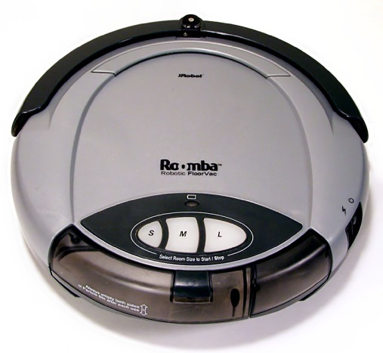
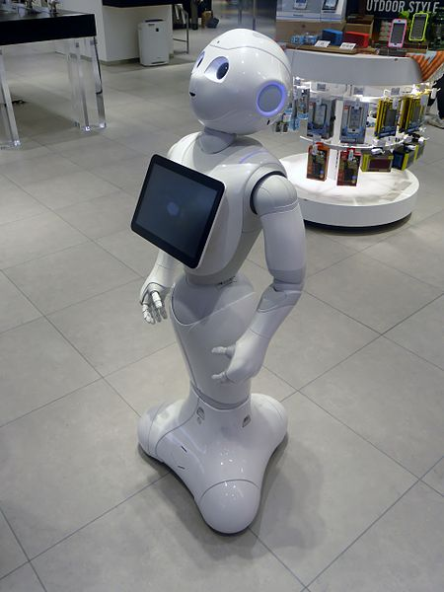
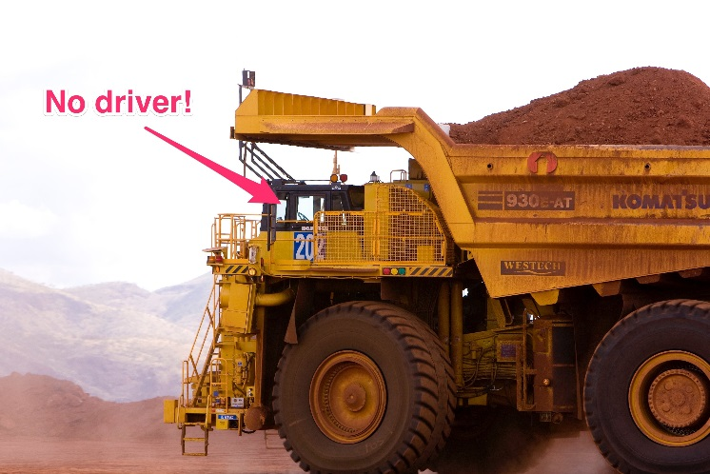
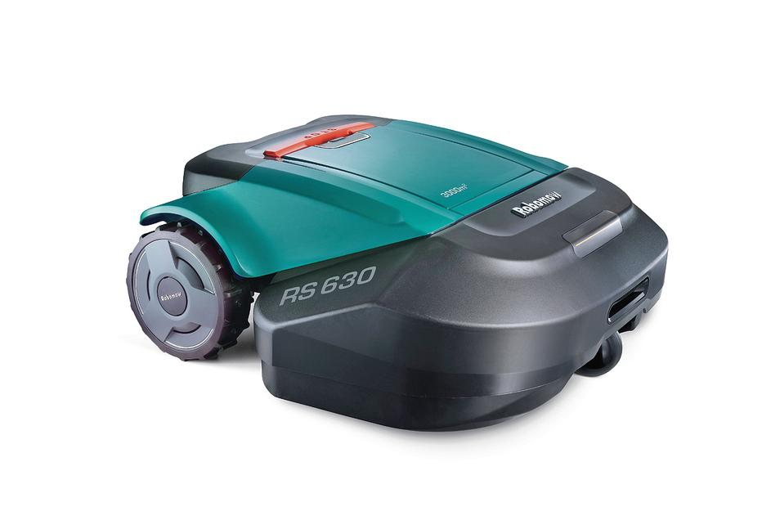
Introduction
Social [1]
Domestic [2,3]
Industrial [4]
https://en.wikipedia.org/wiki/Pepper_(robot)#/media/File:SoftBank_pepper.JPG
Larry D. Moore CC BY-SA 3.0 -https://en.wikipedia.org/wiki/Domestic_robot#/media/File:Roomba_original.jpg
http://www.robotshop.com/en/robomow-rs622-robot-lawn-mower.html
https://www.businessinsider.com.au/rio-tinto-using-self-driving-trucks-to-transport-ore-2015-10?r=UK&IR=T

Slide 4
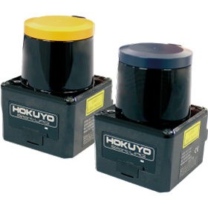
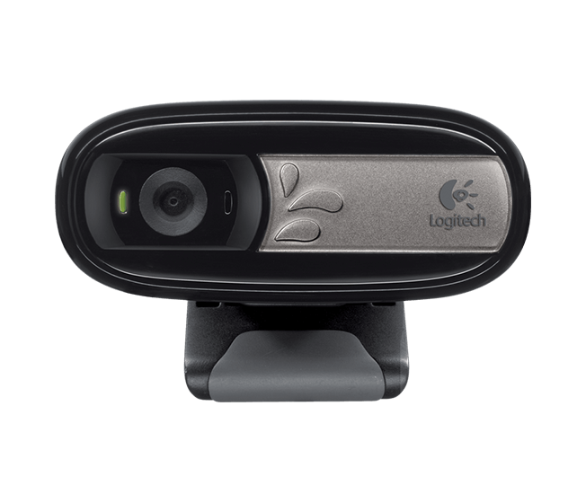

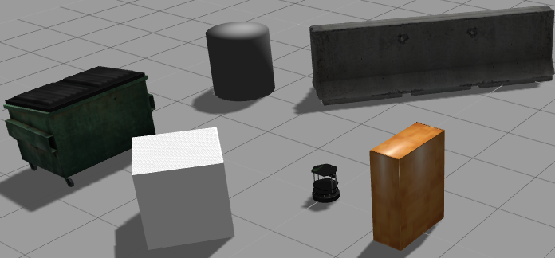
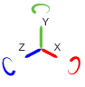
SLAM
Simultaneous Localization and Mapping
Realize Landmarks in Environment
Localize in Map
Approach
Using Sensors like Laser Ranger
Alternative:
Camera
Information-Rich
Easy Access
Inexpensive
Visual SLAM
Landmarks
Motorola Moto G4 Play [3]
Logitech C170 [2]
Robot
Hokuyo Scanning Laser Rangefinder [1]
Turtlebot in Gazebo Simulator
http://babel.isa.uma.es/crumb/index.php/2016/03/10/how-to-simulate-turtlebot-in-rosgazebo/
[1] https://www.hokuyo-aut.jp/search/single.php?serial=167
[2] https://www.logitech.com/en-au/product/webcam-c170
[3] https://www.motorola.com.au/products/moto-g-play
https://au.mathworks.com/help/physmod/sm/ref/6dofjoint.html

Slide 5
Visual SLAM
Optimization
Visual Place Recognition
Visual Odometry
Representation Map

Slide 6
Visual SLAM
Optimization
Visual Place Recognition
Visual Odometry
Representation Map

Slide 7
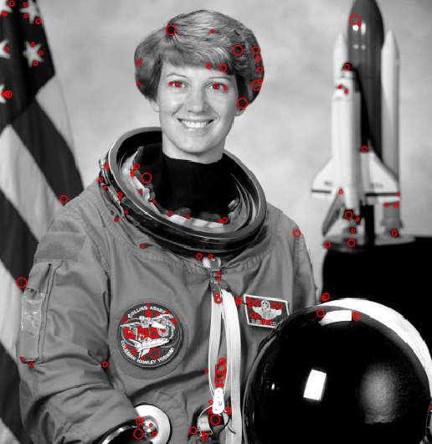
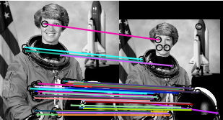
Visual Place Recognition
Recognizing a revisited place
Place Representation
Multiple Local Features
SIFT (Lowe 2004), BRIEF (Calonder 2010), etc.
Method
Bag of Words
FAB-MAP (Cummins 2008)
Feature Correspondence
ORB-SLAM (Mur-Artal 2015)
Feature Correspondence
BRIEF Keypoints (Calonder 2010)
Image - http://scikit-image.org/docs/dev/auto_examples/

Slide 8
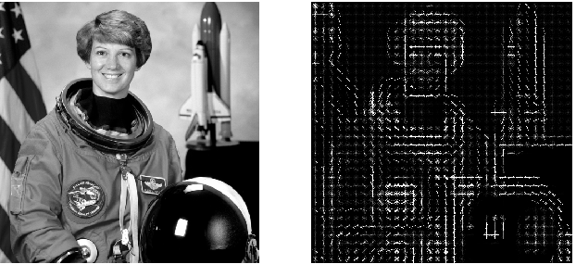
Visual Place Recognition
Place Representation
Global Image Signature
HoG (Dalal 2005), ConvNet (Sunderhauf 2015) etc.
Method
Signature Matching
Dense Image Matching
LSD-SLAM (Engel 2014), SeqSLAM (Milford 2012) etc.
Histogram of Oriented Gradients - HoG (Dalal 2005)
Image - http://scikit-image.org/docs/dev/auto_examples/

Slide 9
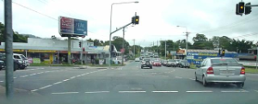
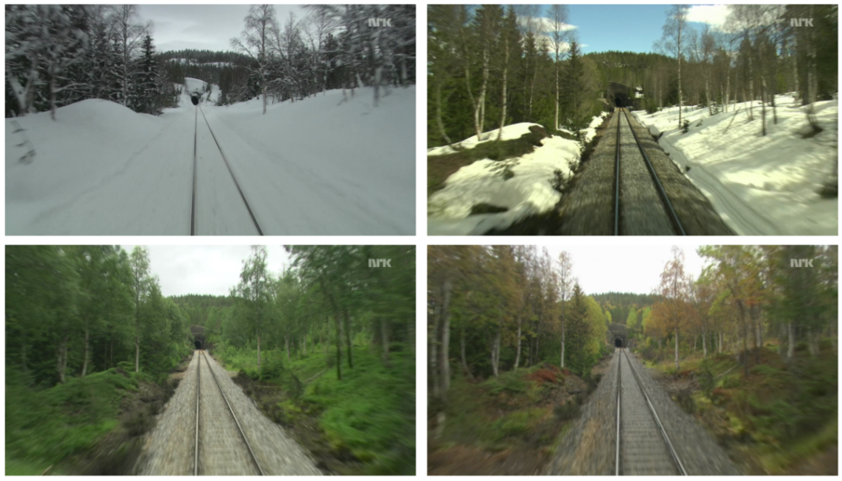
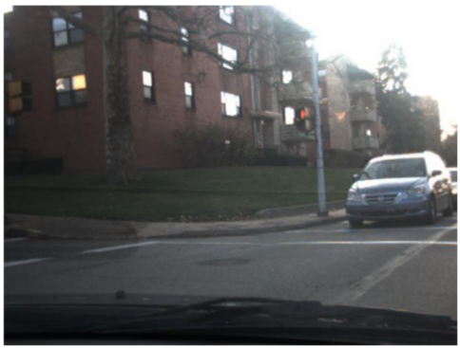
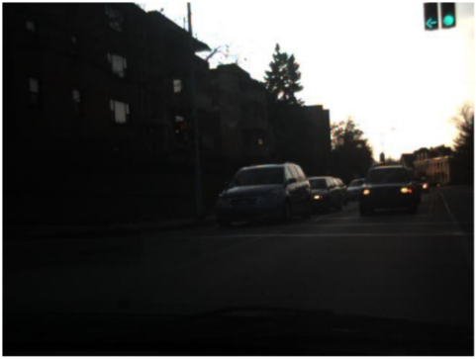

Visual Place Recognition – Challenges
Condition-Invariance
Extreme Changes in Appearance
Seasons
Time of Day
Camera Settings
Seasonal Variations in Nordland (Sunderhauf 2013)
SeqSLAM - Sunny Days vs Stormy Nights (Milford 2012)
Non-linear Intensity Deformation by Automatic Camera Settings (Alismail 2017)

Slide 10
Place Recognition – Summary
Local Image Features
Prone to appearance variations
Global Representations
Prone to viewpoint variations
Deep-learnt features
Robust to both
Missing
3-D Geometric Pose for Condition-Invariant Descriptors

Slide 11
Visual SLAM
Optimization
Visual Place Recognition
Visual Odometry
Representation Map

Slide 12
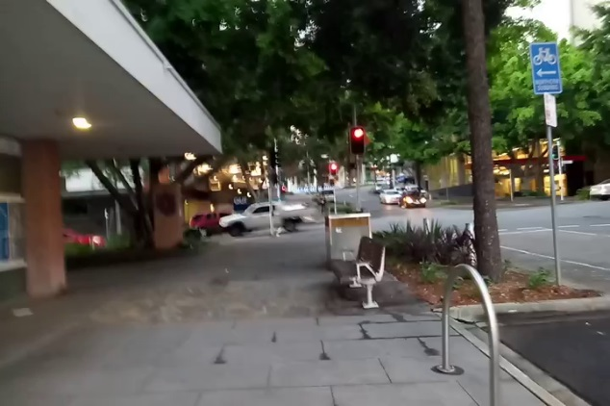
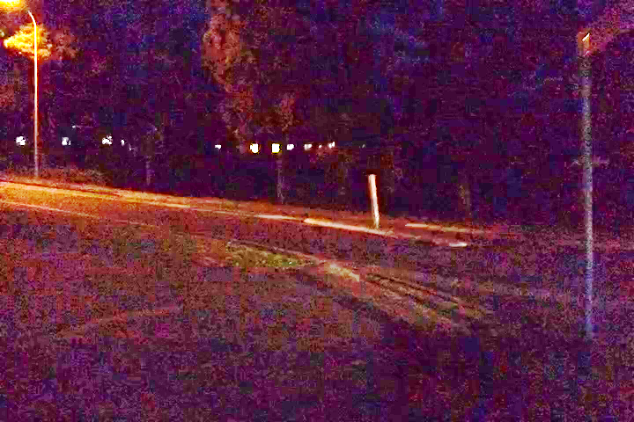
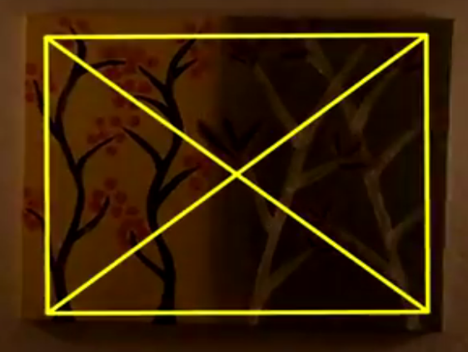
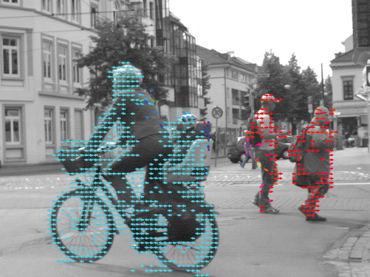
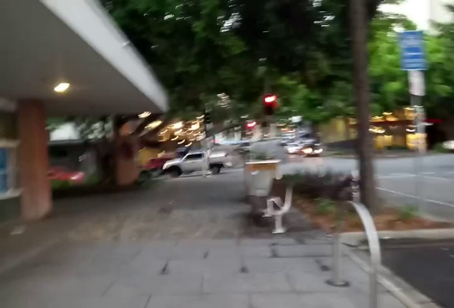

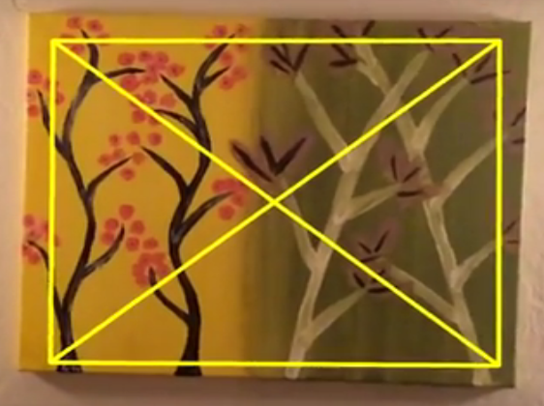
Visual Odometry
Matching consecutive images for Ego-motion estimation
Methods
Feature Correspondence
Direct Whole Image Matching
Hybrid Methods
Deep Learning Based
Challenges
Abrupt Appearance variations
Low light environment
Rapid Camera Motion
Motion Blur
Large Viewpoint Variation
VO Failure is catastrophic for Visual SLAM
CVB Optical Flow
(Alismail 2016)
https://www.commonvisionblox.com/en/products/series/cvb-optical-flow/

Slide 13
Visual SLAM
Optimization
Visual Place Recognition
Visual Odometry
Representation Map

Slide 14
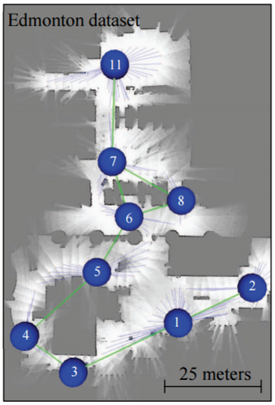
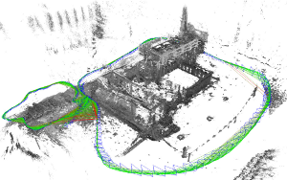
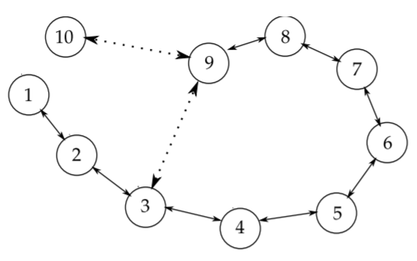
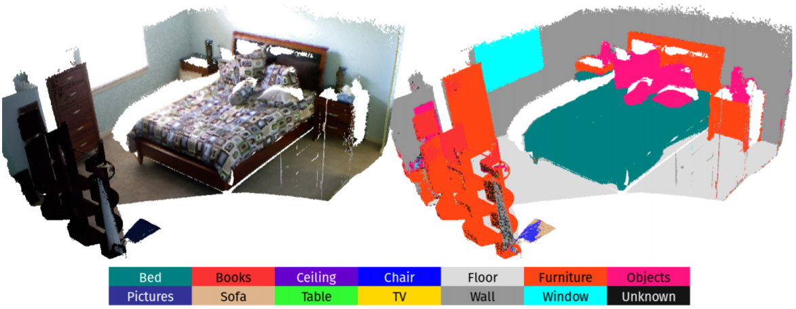
Representation Map
Different Types of Maps
Topological
Metric
Hybrid or Topometric
Semantic
SemanticFusion: Dense 3D Semantic Mapping (McCormac 2016)
Topological Map
Time-Neighbouring Relations (Angeli 2008)
Metric Map Using LSD-SLAM
(Engel 2014)
Metric-Topological Map (Blanco 2008)

Slide 15
Visual SLAM
Optimization
Visual Place Recognition
Visual Odometry
Semantics?
Representation Map

Slide 16
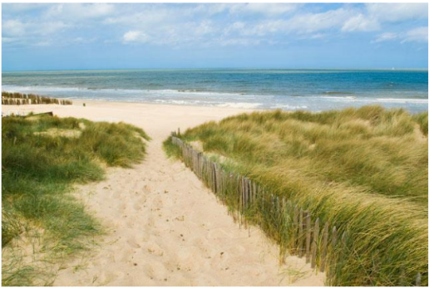
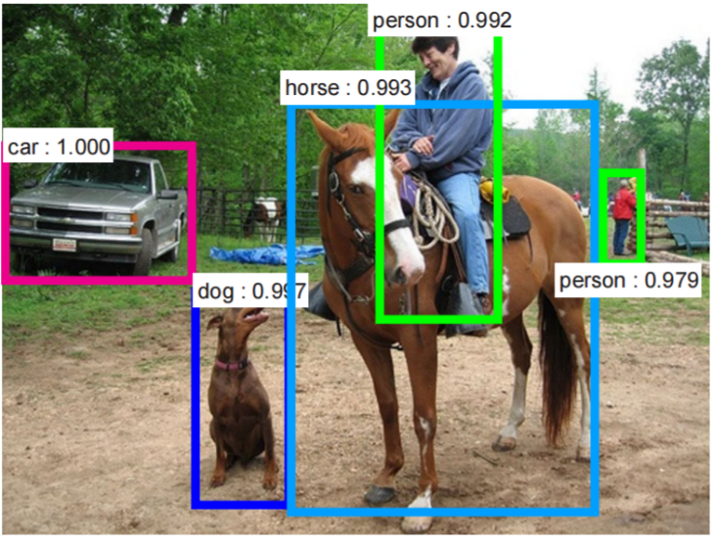
Semantics in Vision
Semantics within an Image
Object Recognition
Sparse or Dense Object Segmentation
Place Semantics
Place-centric
Place Categories and Attributes
(Zhou 2014)
Type of environment
outdoor
Semantic categories:
coast:0.35, ocean:0.30, boardwalk:0.07
SUN scene attributes:
far-awayhorizon, openarea, naturallight, natural, directsunsunny, swimming
Object Detection Using Faster R-CNN (Ren 2015)
http://places.csail.mit.edu/demo.html

Slide 17
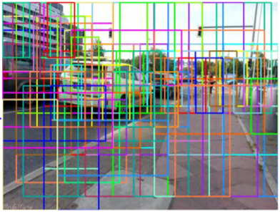
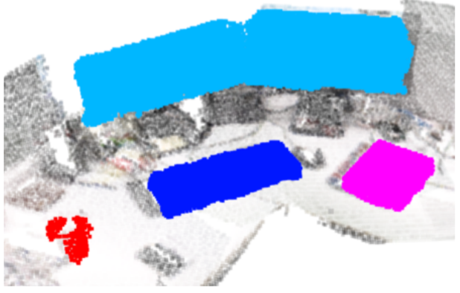
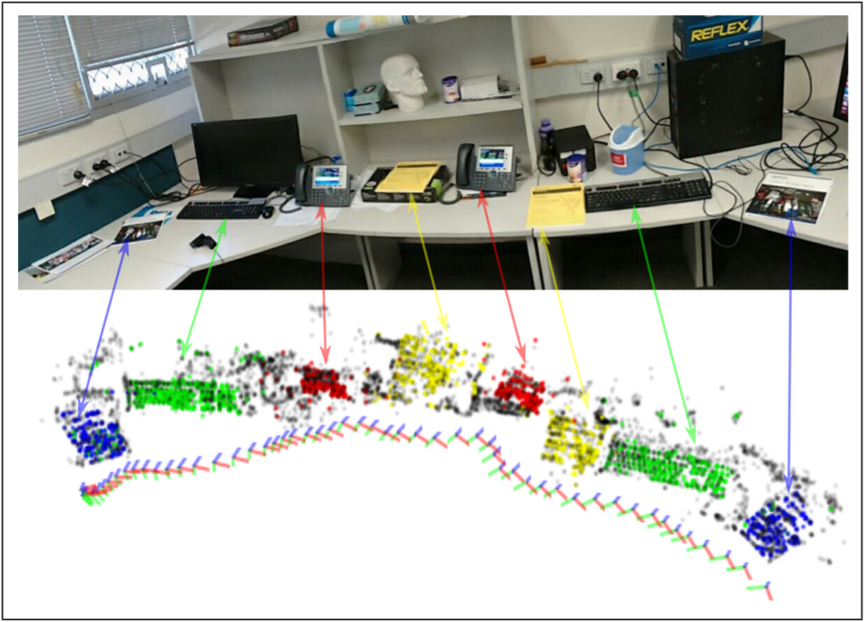
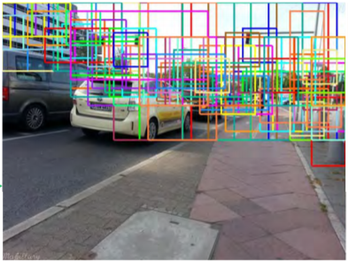
Semantics in Visual SLAM
Objects as Landmarks
Semantic Mapping
Place Recognition
Object-Oriented Semantic Mapping
(Sunderhauf 2017)
Multi-Object SLAM (Dharmasiri 2016)
Object Proposals Refinement Using Roadway Semantics
(Hou 2017)

Slide 18
Research Gap
Visual Place Recognition
Viewpoint- and Condition-Invariant Description
With 3D Relative Pose Estimation
Visual Odometry
Robustness to Dynamic Conditions
Hybrid Approach
Semantics for places
Use Semantics to improve place recognition

Slide 19
Problem Statement
How can we develop a general purpose
6-DoF semantics-aware viewpoint- and condition-invariant visual SLAM system?

Slide 20
Problem Statement
How can we develop a general purpose
6-DoF semantics-aware viewpoint- and condition-invariant visual SLAM system?

Slide 21
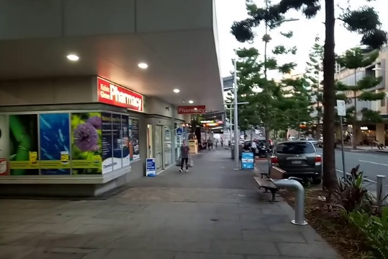
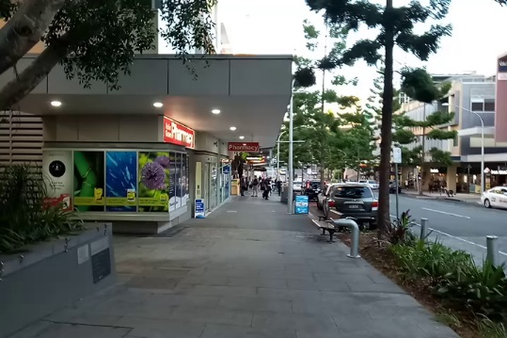
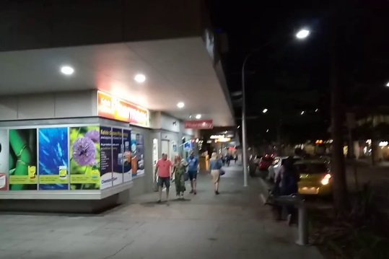
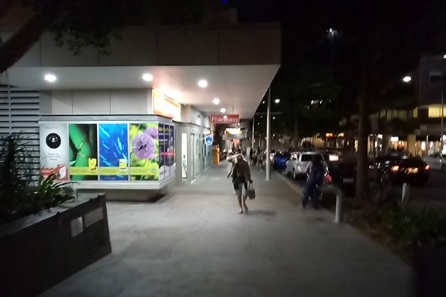
Characterizing System’s Response
viewpoint- and condition-invariant
Variations in Viewpoint and Environmental Conditions
Visual SLAM
Place Recognition
Visual Odometry
Performance Evaluation
Using Real and Simulated Data
Viewpoint Varies
Time of Day

Slide 22
Adapting to Challenging Conditions
viewpoint- and condition-invariant
Low Light and Rapid Camera Movement
Hybrid Visual Odometry
Supplement state-of-the-art system and
Develop methods to
Adapt System Parameters
Eg. Image Scale Pyramid
Address Variable Speed Across Multiple Traverses
Improving Place Recognition Using Motion Cues

Slide 23
Problem Statement
How can we develop a general purpose
6-DoF semantics-aware viewpoint- and condition-invariant visual SLAM system?

Slide 24
Problem Statement
How can we develop a general purpose
6-DoF semantics-aware viewpoint- and condition-invariant visual SLAM system?

Slide 25
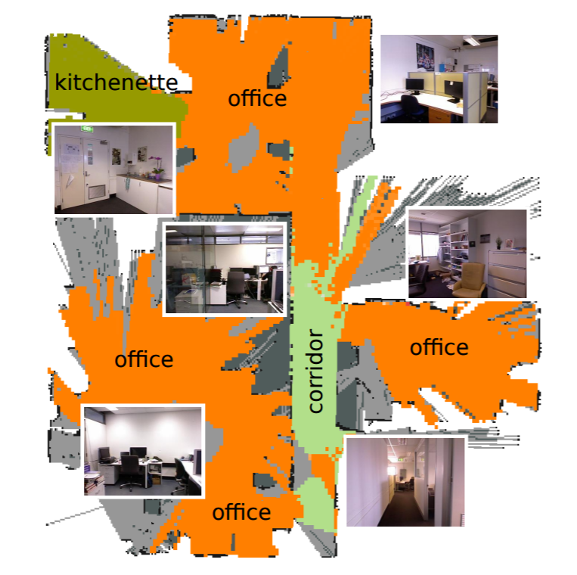
Semantic Segmentation of Environment
semantics-aware, condition-invariant
Planned Approach
Semantic Place Categorization
Places-CNN
Temporal Clustering of Semantic Labels
Segment Environment
Vehicle on Roads - Urban Canyon, Highway, Tunnel etc.
House – Bedroom, Kitchen, Lawn, Stairs etc.
Place Categorization and Semantic Mapping (Sunderhauf 2016)

Slide 26
Semantic Segmentation of Environment
semantics-aware, condition-invariant
Study Appearance Variations Across Place Categories
Effects on Place Recognition
Develop Methods for Seamless Transitions Within Environment
Indoor/Outdoor, Bland/Cluttered etc.
Benchmark place recognition performance against state-of-the-art methods

Slide 27
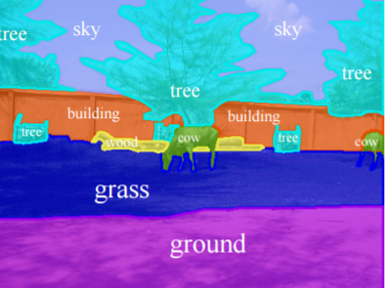
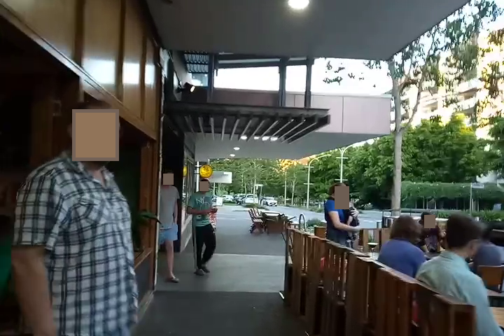
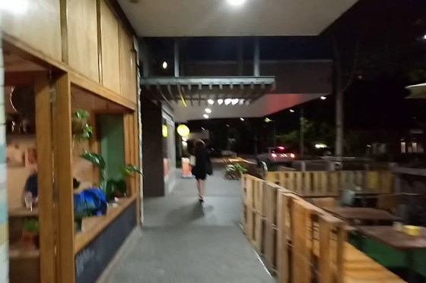
Semantic Segmentation Within Image
semantics-aware, condition-invariant
Planned Approach
Use state-of-the-art semantic segmentation
Object-level or Pixel-level
Learn semantically salient objects/regions for place recognition
Semantic Annotations (Mottaghi 2014)

Slide 28
Semantic Segmentation Within Image
semantics-aware, condition-invariant
Determine Condition-Dependent Objects/Regions
Determine Dynamic Objects
Evaluate Performance with Semantic Masking
Performance Benchmark for place recognition with
A large number of dynamic objects and
Extreme condition variations

Slide 29
Problem Statement
How can we develop a general purpose
6-DoF semantics-aware viewpoint- and condition-invariant visual SLAM system?

Slide 30
Problem Statement
How can we develop a general purpose
6-DoF semantics-aware viewpoint- and condition-invariant visual SLAM system?

Slide 31
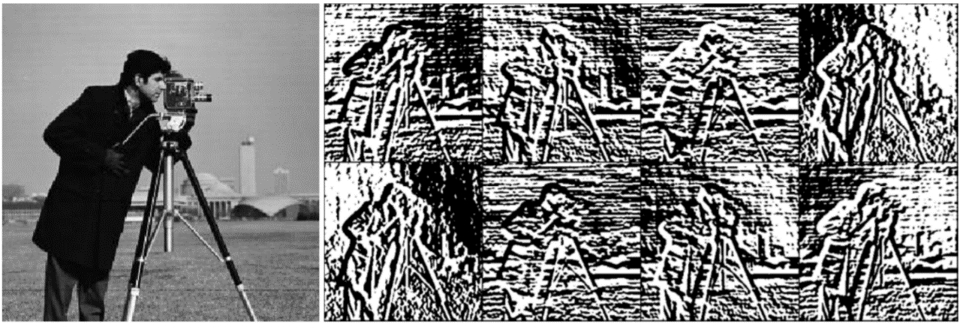
Appearance-Robust 3-D Relative Pose
6-DoF, condition-invariant
Planned Approach
Condition-Invariant Image Representation
Exploring Bit-Planes Descriptor (Alismail 2016)
Direct Image Alignment in LK framework
Descriptor Constancy vs Brightness Constancy
Expected Outcome
Utility for Condition-Invariant Place Recongition
3D Relative Pose Estimation
6-DoF Condition-Invariant Visual SLAM system
8-Channel Bit-Plane Descriptor can be used within a multi-channel LK framework using SSD cost measure (Alismail 2016)

Slide 32
Problem Statement
How can we develop a general purpose
6-DoF semantics-aware viewpoint- and condition-invariant visual SLAM system?

Slide 33
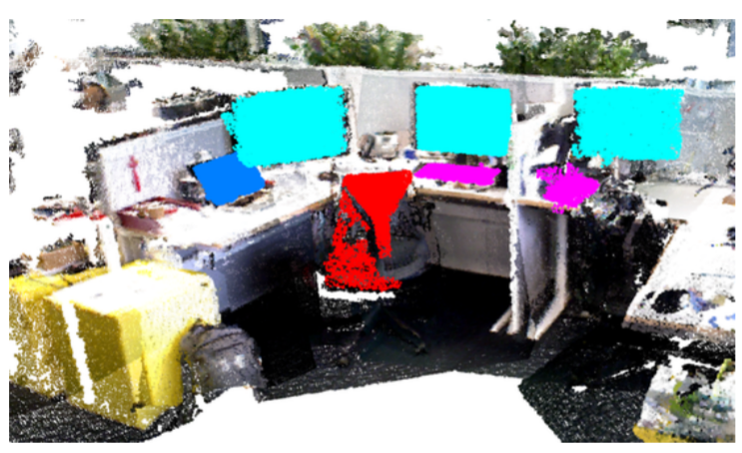
An Integrated System
6-DoF semantics-aware viewpoint- and condition-invariant visual SLAM system
Planned Approach
Semantic Mapping and System Integration
Hybrid Visual Odometry
Visual Place Recognition
Semantic Information
Appearance Robust 3-D Relative Pose
Expected Outcome
3-D Semantically-Interactive Map of Environment
Semantic Navigation Goals
Object Oriented Semantic Mapping (Sunderhauf 2017)

Slide 34
Work Progress
Characterizing System’s Response to Condition and Viewpoint Variations
Performance Evaluation using High-Fidelity Simulation
Accepted at IROS 2016
Skinner, J., Garg, S., Sünderhauf, N., Corke, P., Upcroft, B. and Milford, M.
Adapting to Variations in Environment
Improving Condition-Invariant Place Recognition
Accepted at IROS 2017
Garg, S., Jacobson, A., Kumar, S. and Milford, M.
Ego-motion Estimation in Challenging Conditions
Hybrid Visual Odometry
Improving Place Recognition Using Motion Cues

Slide 35
Work Progress
Characterizing System’s Response to Condition and Viewpoint Variations
High-fidelity simulation for evaluating robotic vision performance
Skinner, J., Garg, S., Sünderhauf, N., Corke, P., Upcroft, B. and Milford, M.
Accepted at IROS 2016
Adapting to Variations in Environment
Improving Condition-Invariant Place Recognition
Accepted at IROS 2017
Garg, S., Jacobson, A., Kumar, S. and Milford, M.
Ego-motion Estimation in Challenging Conditions
Hybrid Visual Odometry
Improving Place Recognition Using Motion Cues

Slide 36
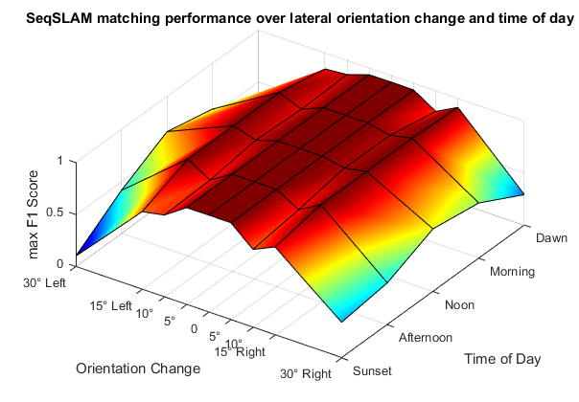
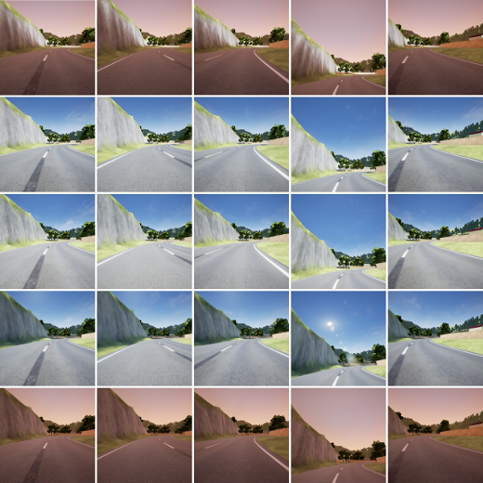
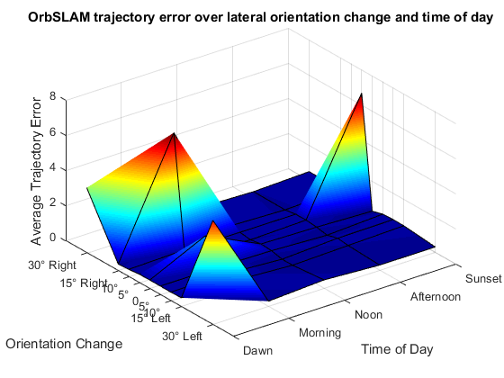
Characterizing Visual SLAM
Performance Evaluation Using High-Fidelity Simulation
Viewpoint Varies
Time of Day
SeqSLAM – Place Recognition
ORB-SLAM – Visual SLAM
(Skinner 2016)

Slide 37
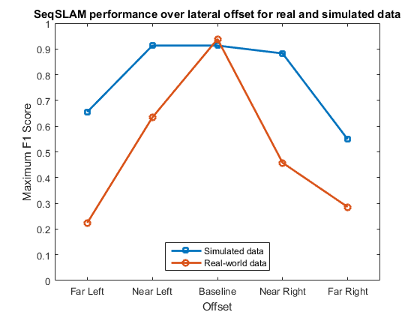
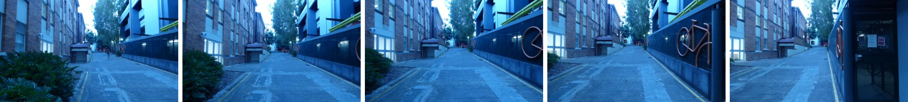
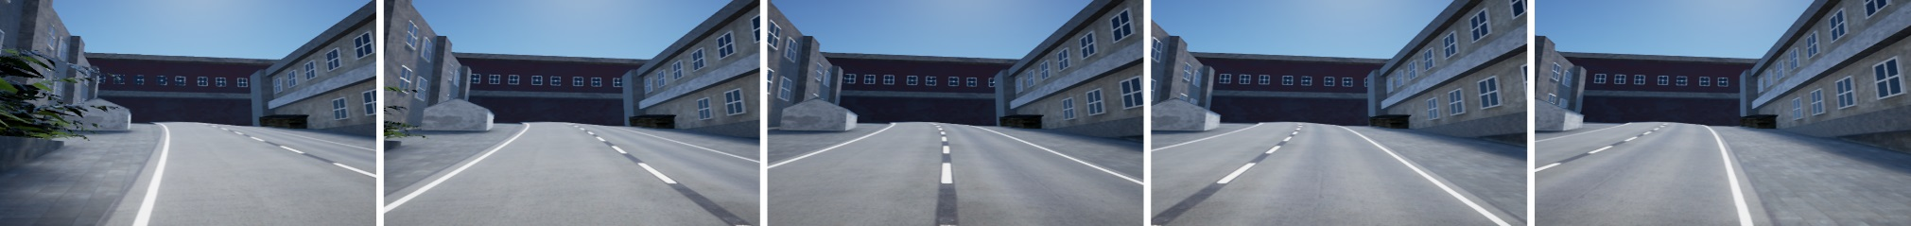
Performance Comparison
Real vs Simulated
Lateral Camera Offset
Real
Simulated

Slide 38
Work Progress
Characterizing System’s Response to Condition and Viewpoint Variations
High-fidelity simulation for evaluating robotic vision performance
Skinner, J., Garg, S., Sünderhauf, N., Corke, P., Upcroft, B. and Milford, M.
Accepted at IROS 2016
Adapting to Variations in Environment
Improving Condition- and Environment-Invariant Place Recognition with Semantic Place Categorization
Garg, S., Jacobson, A., Kumar, S. and Milford, M.
Accepted at IROS 2017
Ego-motion Estimation in Challenging Conditions
Hybrid Visual Odometry
Improving Place Recognition Using Motion Cues

Slide 39
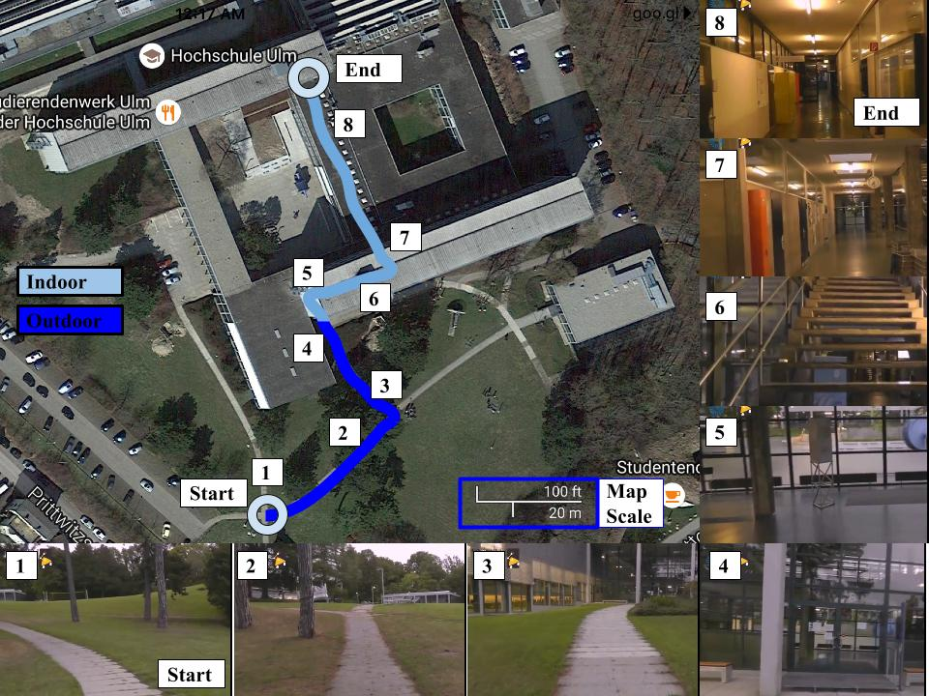
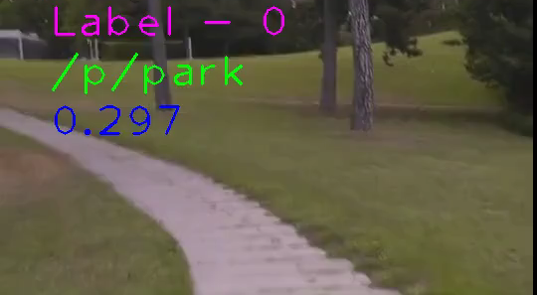
Adapting to Variations In Environment
Semantic Place Categorization
Using Places-CNN
(Zhou 2014)
Label
0 - Outdoor
2 - Indoor

Slide 40
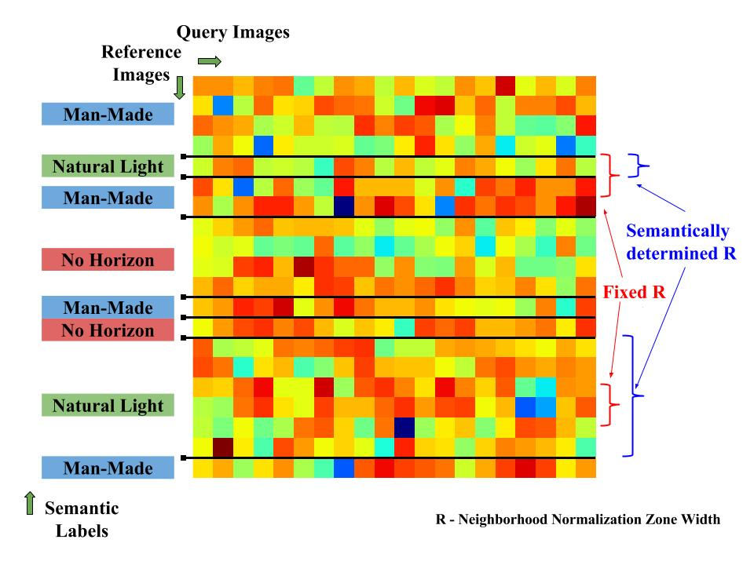
Image Matching Cost Matrix
Two Traverses of Environment
SeqSLAM (Milford 2012)

Slide 41



Parking Lot Data
From Basement to Open Parking
Day Traverse
Night Traverse

Slide 42
Work Progress
Characterizing System’s Response to Condition and Viewpoint Variations
High-fidelity simulation for evaluating robotic vision performance
Skinner, J., Garg, S., Sünderhauf, N., Corke, P., Upcroft, B. and Milford, M.
Accepted at IROS 2016
Adapting to Variations in Environment
Improving Condition- and Environment-Invariant Place Recognition with Semantic Place Categorization
Garg, S., Jacobson, A., Kumar, S. and Milford, M.
Accepted at IROS 2017
Ego-motion Estimation in Challenging Conditions
Hybrid Visual Odometry
Improving Place Recognition Using Motion Cues

Slide 43


Ego-motion for Challenging Conditions
Self-Similarity Matrix

Slide 44

Ground Truth
Often Accurate, But Brittle
Less Accurate, But Robust
Hybrid Visual Odometry System
Supplement state-of-the-art system
Adapt System Parameters
Improve Place Recognition

Slide 45





Improving Place Recognition Using Motion Cues
Dynamic Frame Sampling
Pick frames ‘n’ units apart
Vehicle Moving in Varying Traffic Conditions
(Pepperell 2014)
Vanilla SeqSLAM
Proposed Method

Slide 46

Research Summary
Research
Tasks
Proposed
Plan
Expected
Outcome
Target
Publications
6-DoF Semantics-Aware Condition- and Viewpoint-Invariant Visual SLAM
System’s Response to Viewpoint and Condition Variations
Tests on Real and Simulated Data
Appearance Variations Within Environment
Semantic Map
Salient Objects/Regions for Place Recognition
Appearance-Robust Geometric Transform
System Integration
6-DoF Semantics-Aware Visual SLAM
6-DoF Condition-Invariant Visual SLAM
Condition-Invariant Image Description
Semantic Segmentation of Images
Determine Condition-Dependent and Dynamic Objects
Semantic Segmentation of Environment
Place Categorization improves Place Recognition
High-Fidelity Performance Evaluation
Robustness to Low Light and Rapid Camera Movement
Coarse Ego-motion Estimation
Supplement state-of-the-art Visual Odometry
IROS 2016
IROS 2017
ICRA 2018
IROS 2018
ICRA 2019
IJRR
2019

Slide 47
PhD Timeline

Slide 48
References
Engel, Jakob, Thomas Schöps, and Daniel Cremers. "LSD-SLAM: Large-scale direct monocular SLAM." European Conference on Computer Vision. Springer International Publishing, 2014.
Sünderhauf, N., Neubert, P. and Protzel, P., 2013, May. Are we there yet? Challenging SeqSLAM on a 3000 km journey across all four seasons. In Proc. of Workshop on Long-Term Autonomy, IEEE International Conference on Robotics and Automation (ICRA) (p. 2013).
Alismail, H., Kaess, M., Browning, B. and Lucey, S., 2017. Direct Visual Odometry in Low Light Using Binary Descriptors. IEEE Robotics and Automation Letters, 2(2), pp.444-451.
Milford, M.J. and Wyeth, G.F., 2012, May. SeqSLAM: Visual route-based navigation for sunny summer days and stormy winter nights. In Robotics and Automation (ICRA), 2012 IEEE International Conference on (pp. 1643-1649). IEEE.
Cummins, M. and Newman, P., 2007, April. Probabilistic appearance based navigation and loop closing. In Robotics and automation, 2007 IEEE international conference on (pp. 2042-2048). IEEE.
Alismail, H., Browning, B. and Lucey, S., 2016, October. Robust tracking in low light and sudden illumination changes. In 3D Vision (3DV), 2016 Fourth International Conference on (pp. 389-398). IEEE.
Mur-Artal, R. and Tardós, J.D., 2015, July. Probabilistic Semi-Dense Mapping from Highly Accurate Feature-Based Monocular SLAM. In Robotics: Science and Systems.
Sünderhauf, N., Dayoub, F., McMahon, S., Talbot, B., Schulz, R., Corke, P., Wyeth, G., Upcroft, B. and Milford, M., 2016, May. Place categorization and semantic mapping on a mobile robot. In Robotics and Automation (ICRA), 2016 IEEE International Conference on (pp. 5729-5736). IEEE.
Hou, Y., Zhang, H., Zhou, S. and Zou, H., 2017. Use of Roadway Scene Semantic Information and Geometry-preserving Landmark Pairs to Improve Visual Place Recognition in Changing Environments. IEEE Access.

Slide 49
References
Ren, S., He, K., Girshick, R. and Sun, J., 2015. Faster r-cnn: Towards real-time object detection with region proposal networks. In Advances in neural information processing systems (pp. 91-99).
Zhou, B., Lapedriza, A., Xiao, J., Torralba, A. and Oliva, A., 2014. Learning deep features for scene recognition using places database. In Advances in neural information processing systems (pp. 487-495).
Laffont, P.Y., Ren, Z., Tao, X., Qian, C. and Hays, J., 2014. Transient attributes for high-level understanding and editing of outdoor scenes. ACM Transactions on Graphics (TOG), 33(4), p.149.
Dharmasiri, T., Lui, V. and Drummond, T., 2016, October. MO-SLAM: Multi object SLAM with run-time object discovery through duplicates. In Intelligent Robots and Systems (IROS), 2016 IEEE/RSJ International Conference on (pp. 1214-1221). IEEE.
Jia, Y., Shelhamer, E., Donahue, J., Karayev, S., Long, J., Girshick, R., Guadarrama, S. and Darrell, T., 2014, November. Caffe: Convolutional architecture for fast feature embedding. In Proceedings of the 22nd ACM international conference on Multimedia (pp. 675-678). ACM.
Sünderhauf, N., Pham, T.T., Latif, Y., Milford, M. and Reid, I., 2016. Meaningful Maps $-$ Object-Oriented Semantic Mapping. arXiv preprint arXiv:1609.07849.
Alismail, H., Browning, B. and Lucey, S., 2016. Bit-planes: Dense subpixel alignment of binary descriptors. arXiv preprint arXiv:1602.00307.
Skinner, J., Garg, S., Sünderhauf, N., Corke, P., Upcroft, B. and Milford, M., 2016, October. High-fidelity simulation for evaluating robotic vision performance. In Intelligent Robots and Systems (IROS), 2016 IEEE/RSJ International Conference on (pp. 2737-2744). IEEE.
Mottaghi, R., Chen, X., Liu, X., Cho, N.G., Lee, S.W., Fidler, S., Urtasun, R. and Yuille, A., 2014. The role of context for object detection and semantic segmentation in the wild. In Proceedings of the IEEE Conference on Computer Vision and Pattern Recognition (pp. 891-898).

Slide 50
Thank You!

